Slide 1

Empire State Building

Slide 2
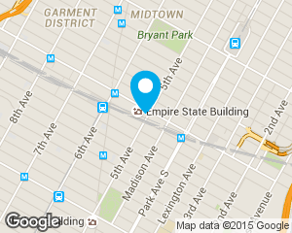
Empire State Building
Official Name: Empire State Building
Location: 350 Fifth Avenue Manhattan, New York 10118

Slide 3
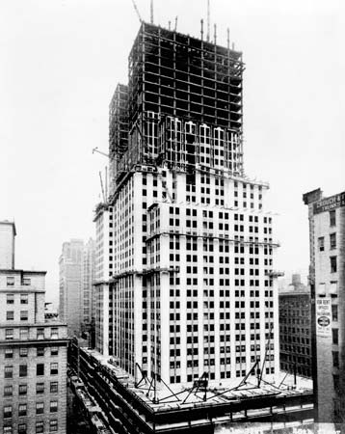
Design and construction
Architect: Shreve, Lamb and Harmon
Structural engineer: Homer Gage Balcom
Main contractor: Starrett Brothers and Eken

Slide 4
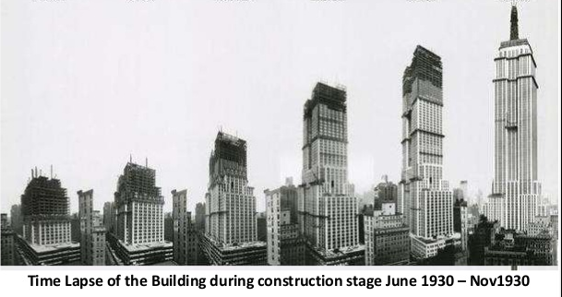
Construction Started: March 17, 1930;
Construction Completed: April 11, 1931;
Added to U.S. National Register of Historic Places: November 17, 1982

Slide 5
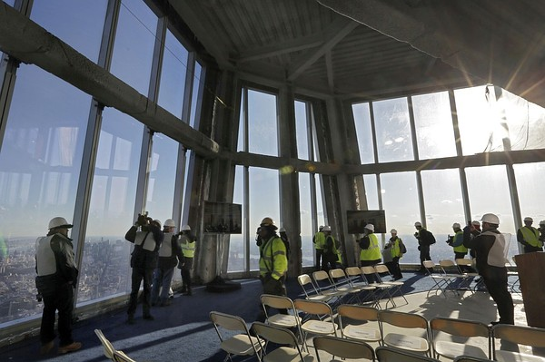
The 86th floor observatory is visited by 3.5 million people every year ;
The Empire State Building is one of the most famous skyscrapers in the world;
Floor Count: 102

Slide 6
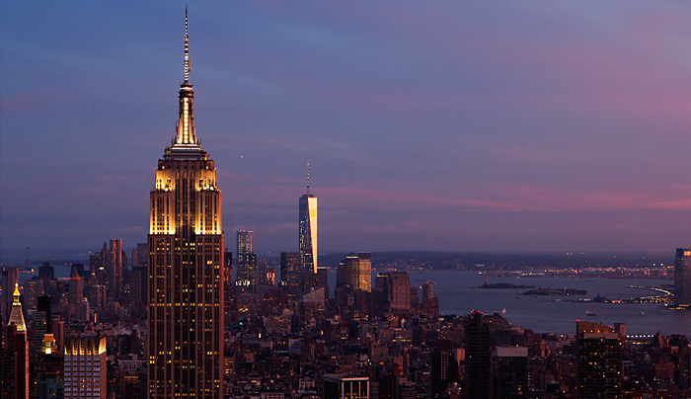
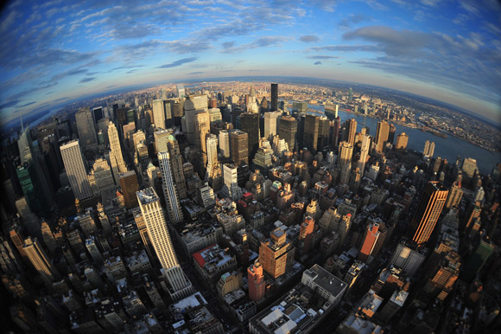



Slide 7
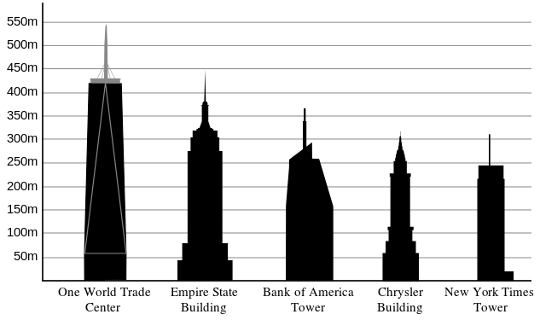
Height comparison of New York City buildings, with Empire State second from left

Slide 8
https://www.youtube.com/watch?v=QYGdLMf9hzM

