Slide 1


Slide 2
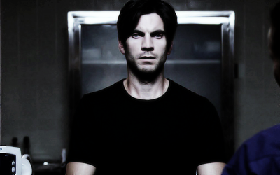
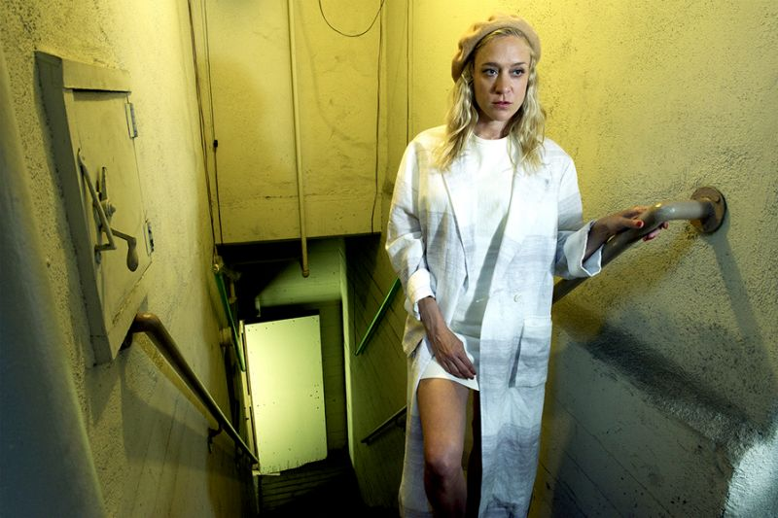
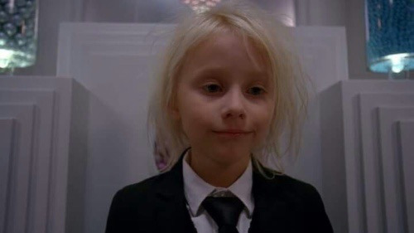
Wes Bentley
Det. John Low
Chloë Sevigny
Dr. Alex Lowe
Lennon Henry
Holden

Slide 3
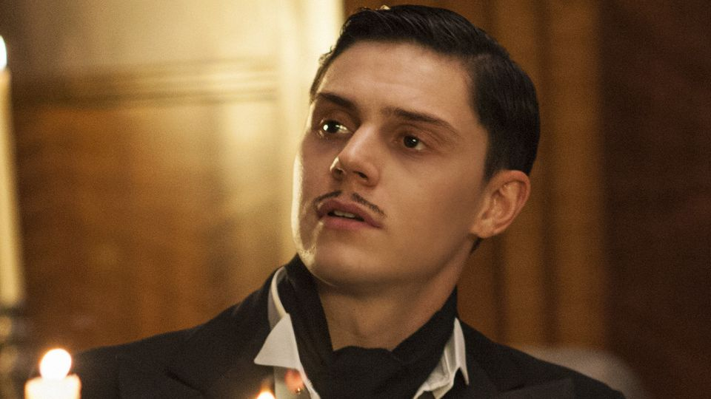

Evan Peters
James Patrick March

Slide 4
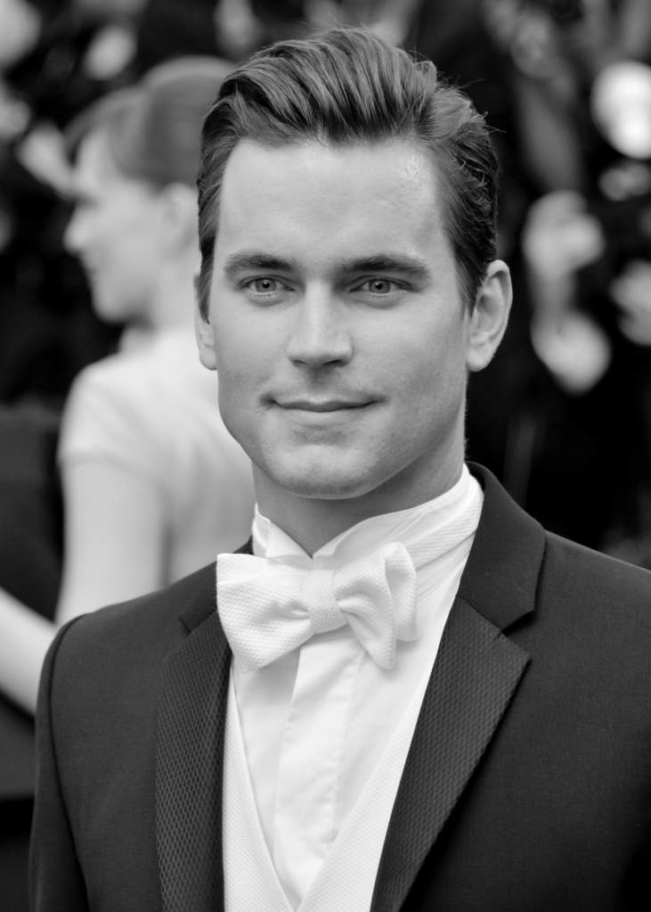
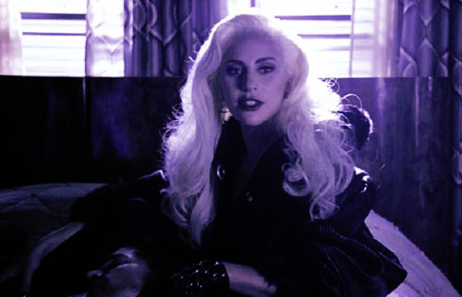
Matt Bomer
Donovan
Lady Gaga
Elizabeth Johnson / The Countess

Slide 5
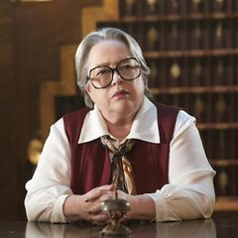
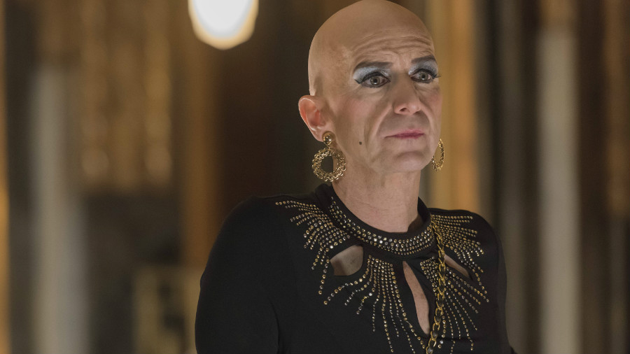
Denis O'Hare
Liz Taylor
Kathy Bates
Iris

Slide 6
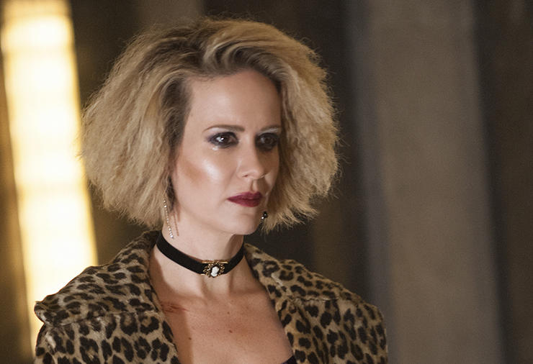
Sarah Paulson
Sally McKenna and Billie Dean Howard

Slide 7
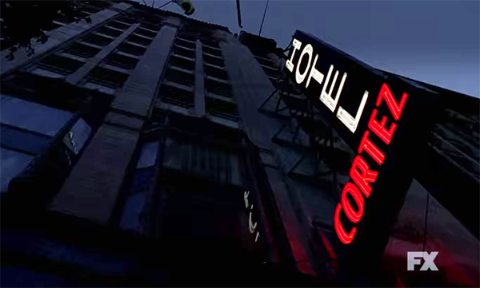
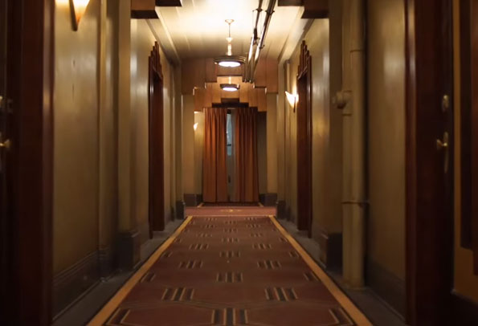


Slide 8
Other seasons

Slide 9

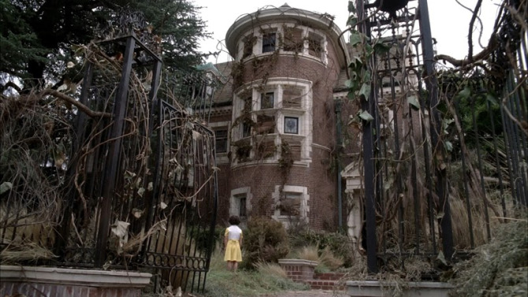
Season 1 :
Murder House

Slide 10
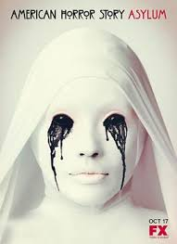
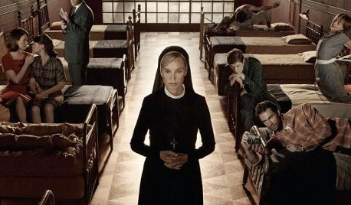
Season 2 :
Asylum

Slide 11

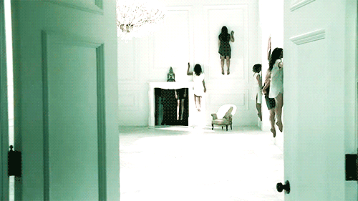
Season 3:
Coven

Slide 12

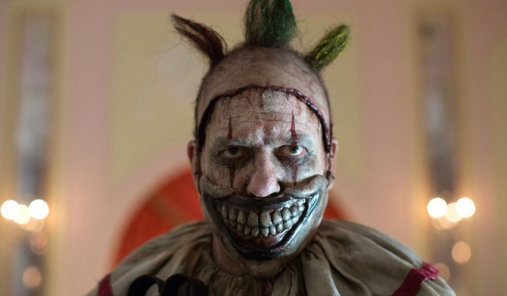
Season 4:
Freak Show

Slide 13
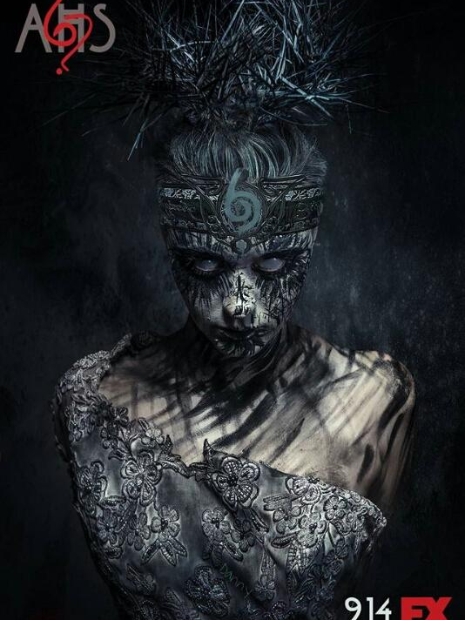
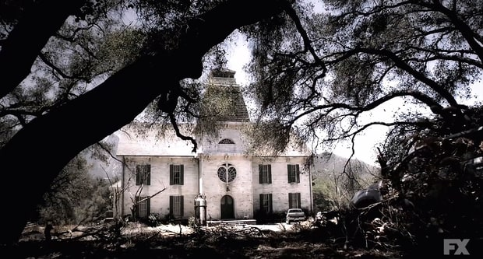
Season 6:
My Roanoke Nightmare

